Slide 1
Raw Sector File Carving & Recovery Engine
A signature-based data recovery tool that scans raw disk sectors for file magic numbers and reconstructs deleted or lost files below the file system layer.
Submitted By:
Submitted to:
Sujoy Devnath (20)
MD. Zahed hossen (19)
Department of Cyber Security Engineering
University of Frontier Technology, Bangladesh
Md Masud Rana
Lecturer,
Department of Cyber Security Engineering
University of Frontier Technology, Bangladesh

Slide 2



01. Project Overview
What This Project Does
Works Below the File System
Reads raw partition sectors directly. Ignores directory tables, partition tables, and file allocation mappings completely.
The application performs raw, file-system-independent recovery. It opens physical or logical drives directly through the Windows API, streams physical disks in 1 MB chunks, and scans every chunk for known file signatures.
Signature-Driven Engine
Utilizes built-in target definitions mapping magic header sequences with explicit binary masks and offsets.
Whenever a signature match is found, everything rom that offset onward is carved out as a candidate file—recovering intact data even after structural file system loss.
Self-Organizing Output
Automatically segregates recovered data pools into target folders categorized dynamically by matching file extensions.

Slide 3
02. Supported Signatures
The engine maps custom file signatures dynamically using standard offsets and byte hex sequences.
Format | Hex Magic Signature | Base Offset | Raw Description & Indicator
JPEG | FF D8 FF | 0 | Standard JPEG SOI (Start of Image) segment boundary
PNG | 89 50 4E 47 | 0 | PNG Signature header boundary (.PNG)
PDF | 25 50 44 46 | 0 | PDF header string representation (%PDF)
MP4 | 66 74 79 70 | 4 | ISO Base Media File marker indicator (ftyp)
ZIP | 50 4B 03 04 | 0 | PKZIP local file header sequence (PK..)
EXE | 4D 5A | 0 | Legacy DOS/Windows MZ executables (MZ)

Slide 4
03. System Design Architecture
The recovery engine architecture utilizes decoupled abstraction segments that isolate core parsing from OS hooks.
1
2
3
RecoveryManager
RecoveryEngine
FileType Hierarchy
→
→
ORCHESTRATION LAYER
EXECUTION LAYER
DEFINITION LAYER
Manages the user interface, displays drive lists, and coordinates the active file recovery lists.
Handles direct hardware streams, scans buffers for match signatures, and saves extracted files to the drive.
Abstract base + 6 concrete classes, each declaring a name, extension, and magic bytes.
Call flow: main() → RecoveryManager::run() → RecoveryEngine::carveDrive() → FileType::getMagicBytes()

Slide 5
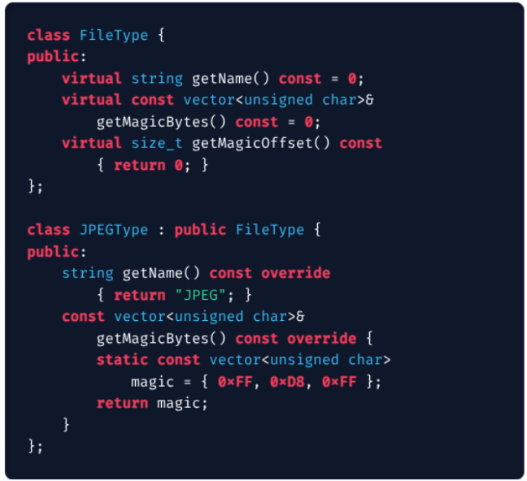
04. Code Walkthrough: Defining Signatures
OOP Polymorphic Design
Strict Abstraction Model The parent interface classes hide configuration logic entirely while enforcing formatting mandates globally.
Pure Virtual Directives Guarantees that child structures supply matching explicit overrides for magic sequence bounds.
Static Allocation Optimizations Declaring vectors statically prevents allocation thrashing during multi-gigabyte block sweeps.

Slide 6
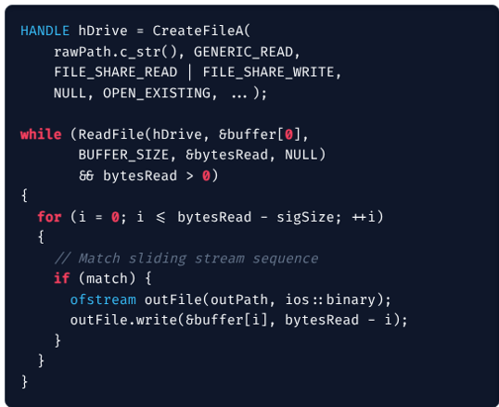
05. Code Walkthrough: Execution Loop
Streaming & Scanning Dynamics
Direct Drive Access Using raw drive path namespaces (\\.\H:) bypasses local NTFS structures completely. Requires Admin privilege.
1 MB Sliding Cache Buffer Constrains local RAM tracking metrics to a static memory footprint regardless of standard target disk limits.
Sequential Pointer Comparison Iterates byte offset checks within active sliding frames to isolate magic header marks seamlessly.

Slide 7




05. Core Concepts Applied
A modern structural decomposition of system mechanisms leveraged by the recovery engine.
OOP Abstraction
Dynamic Polymorphism
RAII Asset Lifecycle
FileType defines a common interface; six subclasses each encapsulate one format's identity.
carveDrive(const FileType&) runs for JPEG, PNG, PDF, MP4, ZIP, or EXE — the correct override binds at runtime.
Windows HANDLE and ofstream wrap OS resources; CloseHandle() and destructors release them deterministically.
File Signatures
Buffered Streaming I/O
Win32 System Calls
“Magic numbers” — fixed byte patterns at a known offset — let the tool identify format without any file-system metadata.
1 MB streaming blocks balance I/O efficiency and cache limits, preventing crashes during large drive analysis.
CreateFileA, ReadFile, GetLogicalDrives, and CreateDirectoryA drive direct, low-level OS interaction.

Slide 8
07. Forensic & Security Lens
Legitimate Dual-Use Applications
Inherent Security Limitations
Digital Investigation Support Acts as a low-level data recovery solution to extract evidence from damaged or unallocated sectors.
Chain of Custody Disconnections No integrated generation of SHA-256 hashes during capture cycles risks evidence validation checks in legal cases.
Administrative Escalation Checks Enforcing explicit root privilege checks keeps standard guest profiles from accessing raw disk sectors.
High Rate of False Positives Basing file boundaries strictly on start-of-file markers (no footer verification) often results in fragmented, corrupt output.
Accidental Deletion Recovery Provides direct, file-system-independent utility to safely salvage partition records lost to accidental format.
No Active Write Prevention Without physical or hardware-level write blocks, scanning live drives risk overwriting critical evidence data points.

Slide 9



08. Carving Challenges
Three core technical limits that basic, sequential disk block scanners face during data recovery.
Split Files
When file data is scattered across non-continuous blocks on a drive, a simple scanner reads unrelated data in between, resulting in broken or corrupt files.
Sector Slack Space
Files rarely fill a sector completely, leaving empty gaps at the end of a block. Important hidden metadata in these gaps is usually missed or skipped by basic scanners.
Shifted Signatures
Certain file types do not start precisely at the zero byte index of a disk block. Standard scanners that look only at fixed block boundaries will miss these files entirely.

Slide 10






09. Future Improvements
Key planned features to upgrade the scanner into an intelligent, cross-platform forensic utility.
Smart Carving
Cross-Platform Port
Forensic Audit Logs
Implement header-footer boundary matching to stop carving precisely at the file limit, reducing file corruption and false positives.
Replace Windows system hooks with POSIX-standard raw device abstractions to support native compilation on Linux and macOS.
Incorporate live SHA-256 hash generation on carved evidence blocks alongside structured PDF session history outputs.

Slide 11

Thank You

